Slide 1


Smart Weather
Guide

Slide 2
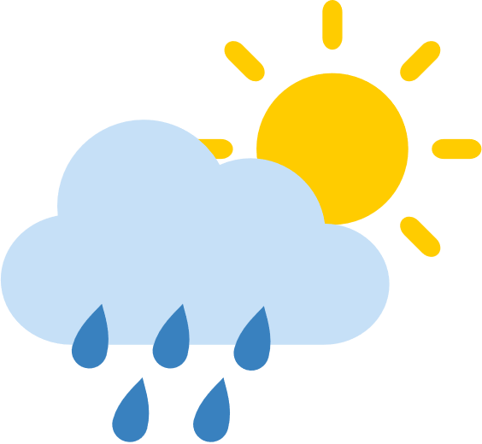
WHY MADE THIS PROGRAM?
Smart Weather Guide was developed for couples and families who are currently living in different cities than themselves.
Running the program will reveal their current location, date, time, weather, and air quality status, plus additional hours in the major cities that you specify at the bottom.
Just by running the program, you can get a lot of information and check the time in other cities where couples and their families live.

Slide 3

TABLE OF CONTENTS
1:
Title
2:
Key Features
3:
Technical Highlights
4:
Dependencies
5:
The Code in Action

Slide 4
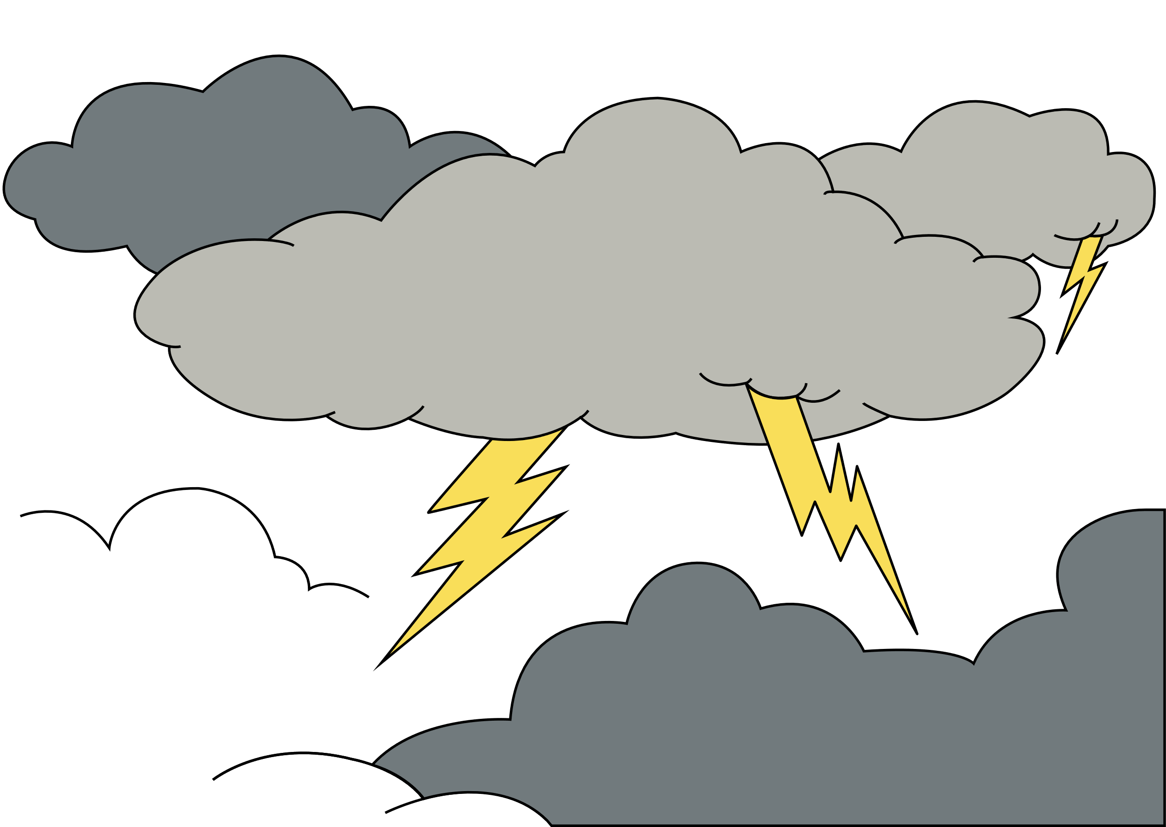
Title
A Python-Based Weather & Clock Application
Project Name: Weather & Clock App
Description: A desktop application that displays the current time, local weather, air quality, and the time in other major cities.
Technology: Built using Python with the Tkinter library for the graphical user interface.

Slide 5

KeY features
What the App Does
Local Time & Date: Continuously updates to show the current system time and date.
Real-time Local Weather: Displays the temperature and weather description for the user's current location.
Air Quality Index (AQI): Provides a status and description of the current air quality.
Global Clocks: Shows the current time in fixed, pre-defined cities around the world, like Brussels and Amsterdam.
User-Friendly Interface: The application window is centered on the screen and has a fixed size for a consistent user experience.

Slide 6

Technical Highlight
Under the Hood
API Integration: Uses the OpenWeatherMap API to fetch weather and air pollution data based on geographic coordinates.
Location Services: Determines the user's current location using geocoder.ip(‘me’). It also includes a fallback location in case the geocoder fails.
Caching: Caches weather icons and user location data to reduce redundant API calls and improve performance.
Multithreading/Scheduling: Uses root.after() for a continuous, non-blocking update of time and weather information.
PyInstaller Compatibility: The code is structured to work seamlessly whether run as a standard Python script or a packaged executable.

Slide 7

Dependencies
Required Python Libraries
tkinter: The standard Python interface to the Tk GUI toolkit for building the application window.
os, sys: For handling file paths and system-level operations, including PyInstaller compatibility.
datetime, pytz: For managing time, dates, and different timezones.
geocoder: To get the user's current latitude and longitude from their IP address.
requests: For making HTTP requests to external APIs (OpenWeatherMap).
deep_translator: To translate location names for a better user experience.
psutil: To check for duplicate instances of the application and prevent them.
Pillow (PIL): For handling and displaying images, such as weather and clock icons.

Slide 8

The Code in aCTION
A Closer Look
Fetching Weather Data
Displaying Global Clocks
The get_weather_data_for_city function makes a GET request to the OpenWeatherMap API, providing the city name and a unique API key.
It returns a dictionary containing the temperature, a weather description, and the icon code.
The update_fixed_city_clocks function iterates through a list of predefined cities and their timezones.
Using the pytz library, it gets the current time for each timezone and updates the corresponding label on the GUI.
This ensures the clocks are accurate and reflect real-world time differences.

Slide 9

Thank you
Thank you for watching my PPTX. Be careful not to catch a cold, everyone!

